Slide 1


Code +

Slide 2
Today
Syntax
Variable
Datatypes
Code +

Slide 3
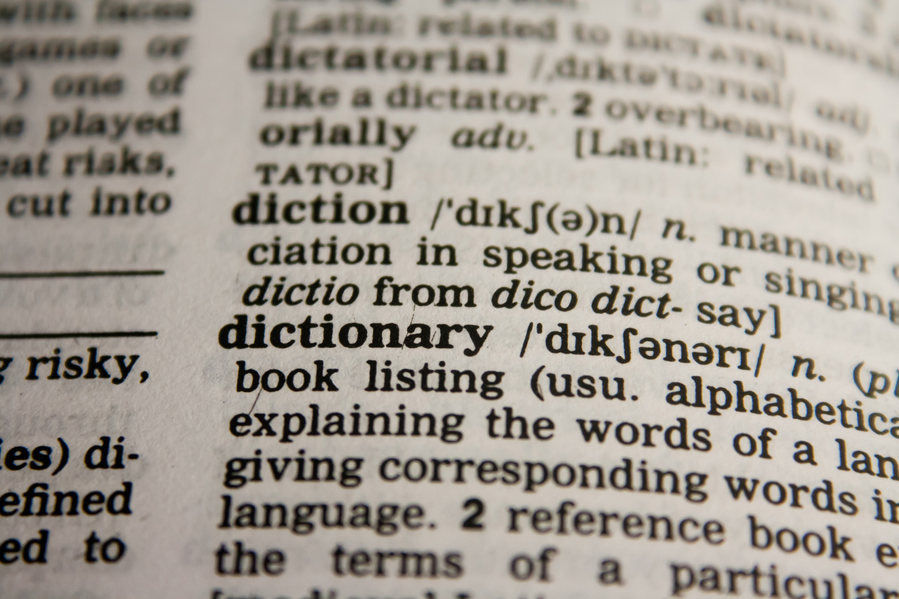
Syntax
import
def
“Jacob”
X = 3
print ()
for ()
class
elif
if
return
else
Code +

Slide 4
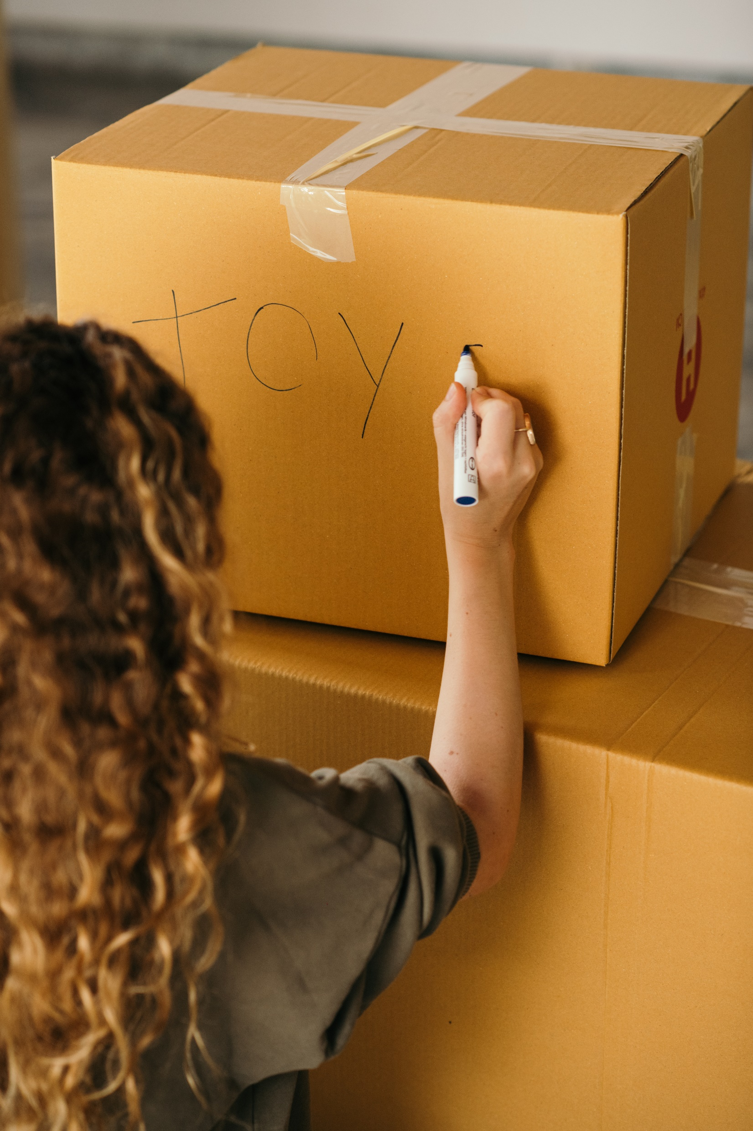
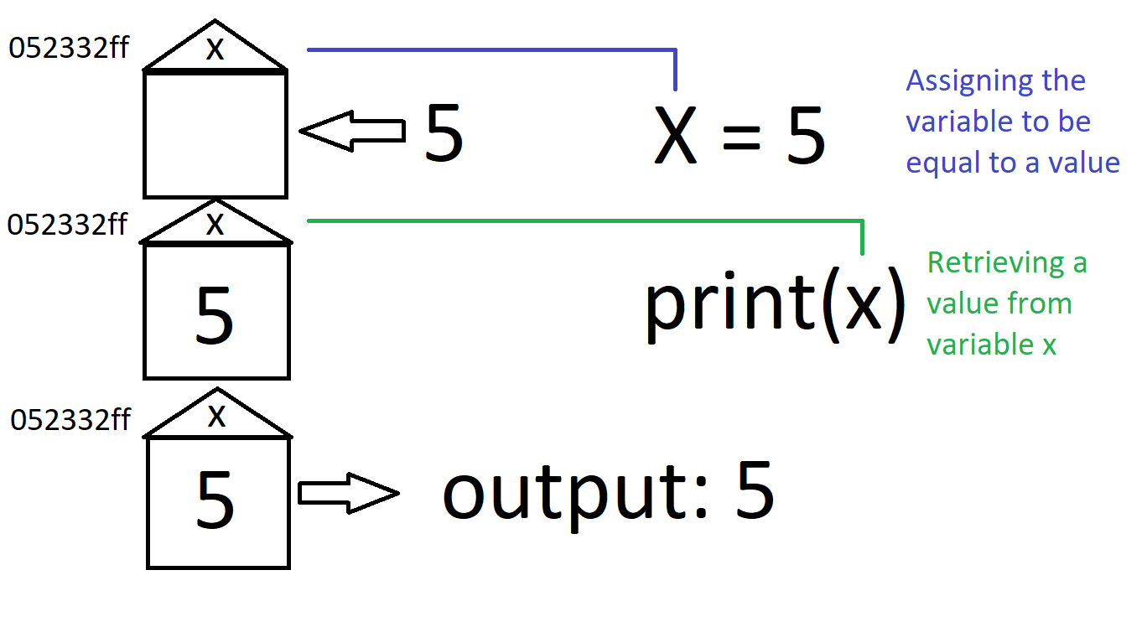
Variable
Code +

Slide 5
Data-types
Two words
What is data?
What types can you think of?
Code +

Slide 6
0
-1
1
integer
-1000
1000
9223372036854775807
Code +

Slide 7
“”
“James”
String
“Hello”
“Python is a high-level, general-purpose programming language. Its design philosophy emphasizes code readability with the use of significant indentation. Python is dynamically typed and garbage-collected.”
Code +

Slide 8
False
boolean
True
Code +

Slide 9
-0.1
float
-13.15
0.11632
6937.394
Code +

